Slide 1


Millennial Myth and Magic

Slide 2
Attracting and Retaining Millennials and other great employees

Slide 3
Lessons Learned
Eliminate Management Malpractice
Agree on a leadership language
Everything starts with recruiting and hiring
Create a Profile
Utilize a Psychological instrument
Don’t exaggerate during recruiting
Make the rules of your game (Banking game etc.) clear

Slide 4
Distinguish between:
Social Research (quantitative research)
Personal Experience (qualitative)
Blogging Mythology
Implicit Bias (Stereotypical Expectations)
Anecdotal Evidence (personal accounts)
Misleading literature and studies
Advice frequently given to Managers

Slide 5
Managers matter A 25 year –long Gallup organization study based on interviews with 12 million workers at 7,000 companies found that the relationship with a manager largely determines the length of an employee’s stay. A Saratoga Institute study found that 50% of work satisfaction is determined by the relationship a worker has with his or her immediate supervisor. A study by the Corporate Leadership Council found that a high quality manager is of standout importance in attracting and retaining key talent.

Slide 6
Attracting and Retaining Millennials and other good employees
What is a Millennial?
What is a Leader?

Slide 7
GENERATIONS
Traditionalists: 1922-1943/46
Baby Boomers: 1943/46-1960/64
Generation X: 1960/64- 1978/82
Millennials: 1978/82-2000
Generation Z: 1996/2000

Slide 8
GENERATIONS
China: Post 1950 (founding of People’s Republic, Post 1960(Communist Party campaigned), Post 1970 (first generation influenced by the West) Post 1980 (first born after One child policy) Post 1990-first born after Tiananmen Square protests) Post 2000 (like Gen.Z digital/internet Gen.)

Slide 9
GENERATIONS
Japan: first baby boomers 1946-1950
Danso gen. 1951-1960
Shinjinrui Gen.1961-1970
Second baby boomers: 1971-1975
Post bubble Gen. 1976-1987
Shinjinrui junior Gen. 1986-1995
Yutori Gen. 1987-2012

Slide 10
GENERATIONS
Influence of historical events
South Africa: Election of 1994 from Apartheid to majority rule
1994 to present ”Born Free gen.”

Slide 11
GENERATIONS
South Korea: 1960-1969 : 386 Gen. named after the Intel 80386 microprocessor also known 386. Those who were in their 30s,
Went to college in the 80s
Born in the 60s
As the Gen got older they were referred to as 486

Slide 12
GENERATIONS
Close to Western but marked by different events
India: Partition Gen. 1944-1963 (independence from British rule)
Transition Gen. 1964-1983 has sympathy for the struggles of previous gen. but did not struggle as deeply
Post Liberalization Gen: 1984-1993 enjoys India’s economic liberalization

Slide 13
GENERATIONS
Russia : Applies same labels as U.S but assigns the opposite personality traits
Soviet baby boomers: post depression US. Materialistic/Russia lived in state controlled economy opposite,/ US individualistic/Russia collectivism
Western Gen X life/work balance Russia: obsessed with creating wealth
Russia- Millennials: Nationalistic/ US least Patriotic Gen.

Slide 14
Leading is Everybody’s Business
What One Asset is needed to be
A Leader without which you cannot
Lead?

Slide 15
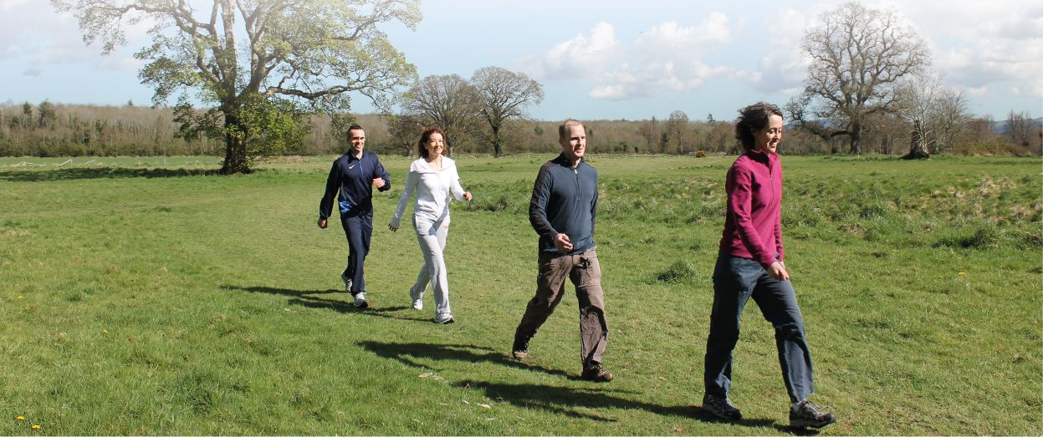
If you think you are a leader but no one is following, then you’re only taking a walk.

Slide 16
Leading is Everybody’s Business
No one is good enough to lead without consent.
Abraham Lincoln

Slide 17
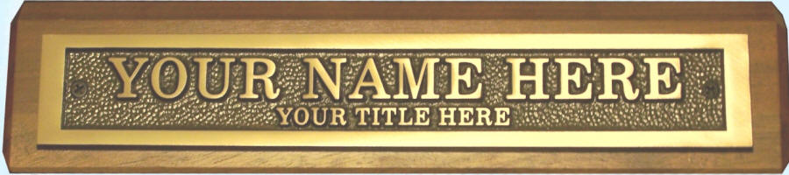
People don’t follow titles.

Slide 18

The Leadership Equation
Leader + Follower(s) = the Power called Leadership

Slide 19

Leadership is Partnership

Slide 20
ENGAGED EMPLOYEE: FOLLOWER
Loyal
Psychologically committed
More productive
More likely to stay at least one year
Less likely to have accidents or steal on the job
NOT ENGAGED: SUBORDINATE
Less productive
Not committed
More likely to miss workdays and more likely to leave
ACTIVELY DISENGAGED: INSUBORDINATE
Physically present -- psychologically absent
Unhappy with their work situation / insist on sharing that unhappiness with co-workers

Slide 21
Results of Employee Engagement
Business units that scored high on the 12 elements consistently
performed better than those that scored low. On average the units
scoring high on employee engagement show on average:
86% higher success rate on customer metrics.
70% higher success rate in lowering turnover.
70% higher success rate in productivity.
44% higher success rate in profitability.
78% higher success rate in safety figures.
Engagement Index Gallup Organization
10 Million Customers
3 Million Employees
200,000 Managers
Data gathered over 20-year period
66 Countries

Slide 22
The Q12 Process
Focus me
Equip me
Know me
Help me see value
Care about me
Help me grow
Hear me
Help me see importance
Help me feel proud
Help me build mutual trust
Help me review my contributions
Challenge me

Slide 23
Discretionary
Effort
Voluntary effort, at one’s discretion,
Freedom
to decide or choose

Slide 24
Discretionary energy is the
get-up-and-go that the
employee is willing to
contribute beyond the
basic requirements of the job.
ジ

Slide 25
Traditionalists (1922-1946)
Personality:
Disciplined
Dutiful
Conformist
Loyal
Conservative
Patriotic

Slide 26
Traditionalists (1922-1946)
Values and the Workplace:
Mission
Structure and consistency
Strong work ethic
Loyalty
Patience
Respect

Slide 27
Traditionalists: Strengths and Challenges
Discipline
Experience
Institutional Knowledge/History
Commitment
Loyalty
Work Ethic,
Thorough, detail –oriented
Change
Technology
Seniority
Motivation/Engagement
Wed to procedure, the system
Conflict
Managing Up to them

Slide 28
Boomers (born 1946-1964)
Personality:
Optimistic
Achievement –oriented
Self Importance
Individuality
Consumption
Cool

Slide 29
Boomers (born 1946-1964)
Cultural Factors:
Self Awareness
Postwar Prosperity
Indulgence and Expectations
Television and Marketing
Activism
Sexual Revolution

Slide 30
Boomers (born 1946-1964)
Values and the workplace:
Hard work
Making a difference
Rewards and Recognition
Individual Growth
Teams
Competition

Slide 31
Boomers: Strengths and Challenges
Spiritual
Experience
Idealism
Individualism
Open-ness
Relationship/Networking
Work ethic
Technology
Managing up to them
Judgmental
Control/ Competition
Too process oriented
Conflict

Slide 32
Generation X (1961-1981)
Baby Busters
Engage through Social Media
Facebook is dominated by Xers

Slide 33
Generation X (1961-1981)
Cynical: distrust authority
Distrust large organizations
Distrust religious institutions
Distrust Government

Slide 34
Generation X (1961-1981)
Entrepreneurial:
founders of Google, Twitter and Amazon

Slide 35
Generation X (1961-1981)
Educated:
more than 60 percent went to college
Individualistic:
unstable childhood, both parents worked, many divorced;
over-parenting is the result.

Slide 36
Generation X (1961-1981)
Casual Disdain for Everything, Especially authority
Hate being micromanaged
Want freedom coupled with responsibility
Technologically astute
Flexible and Adaptable
Sometimes disloyal to employers or
Uncommitted to jobs
Committed to their own survival

Slide 37
Generation X (1961-1981)
Work Life Balance:
No trust that that the job will be there in the future so why sacrifice everything, especially family for it.

Slide 38
Generation X (1961-1981)
Casual Disdain for Everything, Especially authority
Hate being micromanaged
Want freedom coupled with responsibility
Technologically astute
Flexible and Adaptable
Sometimes disloyal to employers or
Uncommitted to jobs
Committed to their own survival

Slide 39
Generation X (1961-1981)
Values in the Workplace:
Autonomy
Diversity
Informality
Competence
Technology
Ongoing learning & Development
Feedback
Balance

Slide 40
Generation X: Strengths and Challenges
Independent
Results Oriented
Efficiency minded
Creative
Adaptable
Tech savvy
Unintimidated by authority
Less trusting/cynical
Impatient
People and political savvy
Easily bored
Loyalty
Working in teams
Micro managing: they really hate it

Slide 41
Mentoring X Mentoring Do’s
Casual, friendly work environment
Involvement
Flexibility and freedom
A place to learn

Slide 42
True or False
Millennials are lazy, entitled job hoppers,
and it is difficult to make them long term
employees.

Slide 43
True or False
Millennials don’t have a sense of good manners which includes not respecting their elders.

Slide 44
True or False
We must give in to Millennials

Slide 45
True or False
Millennials need to be babied and hand-held

Slide 46
True or False
Millennials want to be handed everything without putting in the work

Slide 47
True or False
Millennials are given more than any other generation but still aren’t satisfied

Slide 48
True or False
Millennials think they can walk right into the CEO’s office and gain an audience

Slide 49
Lessons Learned
Playing the Money Game
Competitive on the Outside and Equitable
On the Inside

Slide 50
True or False
Millennials are the same as other generations. They want the same things.

Slide 51
True or False
Millennials will eventually grow up and be driven by money like the rest of us.

Slide 52
True or False
They don’t know a lot and have short attention spans.

Slide 53
True or False
Millennials want to be in charge on day one.

Slide 54
True or False
Millennials need work to be fun.

Slide 55
True or False
Millennials want to be left alone.

Slide 56
True or False
Millennials want their supervisors to do their work for them.

Slide 57
True or False
Millennials don’t care about climbing the corporate ladder, getting traditional benefits packages or in making money.

Slide 58
True or False
Millennials learn only from on-line sources

Slide 59
True or False
Millennials will never make good managers because they are to self-focused and absorbed.

Slide 60
Millennial
Myths
Most of the Preceding statements
Are
False

Slide 61
Celebrate diversity
Optimistic/realistic
Self-inventive/individualistic
Rewrite the rules
Killer lifestyle
Irrelevance of institutions
Internet
Assume technology
Multitask fast
Nurtured
Friends = family
Always Connected generation
Millennials
75 million
Born around
1980 to 2000

Slide 62
Millennials: Personality
Optimistic
Ordered
Respectful
Open-minded
Nonjudgmental
Technologically supreme

Slide 63
Millennials : 15 most successful in the World
Mark Zuckerberg, Facebook
Katy Perry
Jennifer Lawrence
Justin Bieber
Michele Phan (beauty products)
Bruno Mars
Pewdiepie (gaming)
Michael Phelps (Olympic athlete 28 medals 23 Gold)
Jessica Alba
Justin Timberlake
Lady Gaga
Ivanka Trump
Beyonce
Prince William/Kate Middleton
Adele

Slide 64
Millennials : Cultural Factors
Information Revolution
Digital Natives: Digitally Engaged
Omni channel world
Peace
Prosperity /Opportunity
Globalization
Diversity
Structure: Helicopter Parents

Slide 65
Millennials: “Marketing to”
They get Marketing (grew up with it. Respect their intelligence.
They are not your Fans (They are active participants. Shape the conversation/own things they engage in
Experiences make them rich (in debt can’t afford a house but can afford an $ 800 primo festival experience
Knowledge is everything (millennial currency. They want to know: where and how it is sourced, corporate practices, how staff is treated, personal character of leaders. All elements must align.
Big is Bad (big brands have let them down, leaders and industries collapse. They trust each other and micro-influencers
Chat is King (Primary means of communication. Expect brands to be available 24/7 Snap will eclipse text messaging

Slide 66
Millennials : “Marketing to”
They get Marketing (grew up with it. Love humor. Respect their intelligence.
They are not your Fans (They are active participants. Shape the conversation/own things they engage in
Experiences make them rich (in debt can’t afford a house but can afford an $ 800 primo festival experience
Knowledge is everything (millennial currency. They want to know: where and how it is sourced, corporate practices, how staff is treated, personal character of leaders. All elements must align.
Big is Bad (big brands have let them down, leaders and industries collapse. They trust each other and micro-influencers
Chat is King (Primary means of communication. Expect brands to be available 24/7 Snap will eclipse text messaging

Slide 67
Millennials : “Marketing to”
Growth is Good (They are looking to grow on a personal level . Give them access to events , ideas and information.
Entertainment is Expected, Everywhere :They never learned to be bored. Things move quickly and they like it. 15 second ads are too long. Brands must be the entertainment not sponsor it.
They’re ruthless. If you let them down they are on to the next thing. They understand they are in control and vote with their dollars. If you make a mistake atone publicly don’t try to sweep it under the carpet.
Irony Reigns: The offbeat and oddball the better. Humor is the way to show millennials you get them and respect their intelligence. Humor is their weapon of choice and they maintain optimism. It is a common language among friends.

Slide 68
Millennials or New Workplace Preference
No blind loyalty to a Corporation, Status and Title or Seniority
M. Loyalty resembles the kind of loyalty in a free market economy
Transactional Loyalty : negotiate it

Slide 69
Millennials /Digitally enabled and
influenced Preference
They will do whatever it takes
as long it is being kept track of and they are getting credit for their work

Slide 70
Millennials : modern workplace culture
Modern talent
They have more information in their heads and more information at their fingertips than anyone ever has had

Slide 71
Millennials
They want to hit the ground running. Identifying ,unidentified problems and solving them. They want to be significant from the start.

Slide 72
Millennials
They want engaging, involved workplaces. Connect what we do to the mission. Let us work have some flexibility about how, where and when we work.

Slide 73
Millennials
No desire to be left alone. They want
guidance , feedback,
and someone who knows them and what they do
As well as keeping track of their successes.

Slide 74
Millennials
Want teachers as managers to assist them in doing their work better and faster.

Slide 75
Millennials
They may not be focused on climbing the ladder but they are interested in development and progression.
They will move up but in non-traditional ways but
Proofing their ability to add value.

Slide 76
Millennials
They care about money and benefits and are savvy about researching their possible employer’s offerings as compared to others.
However it is not the highest priority but an element that can keep employment possibilities open.
They will want to know

Slide 77
Lessons Learned
Playing the Money Game
Competitive on the Outside and Equitable
On the Inside

Slide 78
Millennials
Care about Relationships, tasks, learning opportunities,
schedule, location,
mission and community involvement

Slide 79
Millennials
Will respect what you bring to the table but they want you to respect what they bring

Slide 80
Millennials
Will learn what is easy to learn from
computers but they also learn from coaching, direction, guidance, support, and shared knowledge.

Slide 81
Millennials
Want you to help them build a career one day at a time.
They do not rule out the possibility of a long term experience.

Slide 82
Millennials
They will make good managers because they already do.
They can learn this skill just as well as any other generation.

Slide 83
Millennial Magic is the Future

Slide 84
It ‘s Not Lazy. It is productivity redefined.
It is not Entitled , It’s Entrepreneurial
It’s not hand-holding it is Agility
It’s Not Disloyal It is Seeking Purpose.
It is not Authority Issues, It’s Respect Redefined
Two
sides
Of
The
coin

Slide 85
Millennials make up 40% of the workforce and in 10 years this will double

Slide 86
Mentoring Do’s for Millennials
· Structured, supportive work environment
· Personalized work
· Interactive relationship
· Be prepared for demands, high expectations

Slide 87
Learn how to Get People to Follow You

Slide 88
Millennials want more frequent feedback and personalized attention
They want a Coach and a Teacher not a Boss

Slide 89
Create a Culture that
Allows for Influencing
Upward (Feedback to Boss)
Create a system of monthly feedback
For Each Employee
ジ

Slide 90
Millennials want work/life balance
They observed stressed out parents who were out of balance
ジ

Slide 91
Millennials aren’t willing to sacrifice life for work.
They want to be judged on results not time spent
ジ

Slide 92
The belief among many baby boomers that their worth is determined by how many hours they put in, how early they get there, and how long they stay. This belief is no longer valid in today’s society. It is not a matter of how long you are at the office, it is about how productive you are. Millennials want flexible work schedules. They want to work from home.
They expect personal development (attending conferences and training)

Slide 93
Millennials are global
they appreciate
diversity and other cultures
ジ
(AIESEC Exchange)

Slide 94
Millennials: Great team players
They move in and out of the leader and follower roles Gracefully
ジ

Slide 95
Create Leaders at Every
Level of Your Organization
ジ
Share the leader role

Slide 96
Practice Building
Alliances and Partnerships
ジ
Leadership is Partnership
Success is a Team Sport

Slide 97
Millennials :
Aren’t automatically
loyal to Authority

Slide 98
Leading is beyond Authority:
It is Person to Person not
Position to Position
Owning a title doesn’t guarantee
followership

Slide 99
Growth and development
are vital for Millennial Engagement

Slide 100
Millennials want supervisors/team leads to focus on their strengths and make their weaknesses irrelevant
ジ

Slide 101
Millennials are energized by knowing that their work resonates with their Purpose.
They want to know that they are making a difference.
ジ

Slide 102
Increase Your Personal Energy Level
and the
Level of Energy of Your Team
ジ
Understand that:
Leading is Management of Energy

Slide 103
Millennials are naturals for
Creating an authentic
Learning Organization
They are centers of Curiosity
And excellent team players
ジ

Slide 104
It is not differences that divide us.
It’s the judgments about each other that do.
Margaret Wheatley

Slide 105
Egalitarian-----------------Hierarchical
best manager/boss is a facilitator among equals.
The organization tends to be flatter and communication often skips hierarchical lines.
It is all right to disagree with the boss even in public.
It is possible for associates to move on a project without getting the boss’s approval.
It is acceptable to e-mail associates above you and below you. The order of seating in a meeting is not structured according to status or position.
The manager/boss is strong and leads from the front.
Status is important and the organization has many layers.
Communication often follows fixed lines.
Associates defer to the boss’s opinion especially in public.
Approval before moving on a project is usually required.
You may be seated and spoken to in order of your status and position.

Slide 106
Egalitarian--------------------------Hierarchical
Romania
US
Denmark
Israel
The Netherlands
Australia
Japan
China
India
Korea

Slide 107
Know that your words, internal and external, create your reality.
How are you speaking?

Slide 108
JUDGMENTAL
Reactive/autocratic
Critical/negative
Close minded
Know-it-all-self-righteous
Blame oriented
Own point of view only
Inflexible/rigid
Defends assumptions/rationalizes
Primary stance: protective
LEARNER
Responsive and thoughtful
Appreciative and has humility
Open minded
Comfortable not knowing
Takes multiple perspectives
Flexible/adaptive/creative
Questions assumptions
Mistakes are to learn from
Possibilities seen as unlimited
Primary stance: curious

Slide 109
Judgmental Questions include:
What’s wrong with me?
Whose fault is it?
Why are they so stupid?
How can I prove that I’m right?
Haven’t we been there, done that?
Why bother?
Results of Judgmental Questions:
A mood of pessimism, stress, and limitation
A mindset that’s judgmental, reactive, inflexible
Relating with “attack or defensive” behaviors

Slide 110
Learner Questions include:
What do I want?
What works?
What are the facts and what can I learn?
What are my choices?
What action steps make sense?
What’s possible?
Results of Learner Questions:
A mood of optimism, hope, and possibilities
A mindset that’s thoughtful, understanding, flexible
Relating that is connected and collaborative

Slide 111
Leading is Energy Management
Learning LANGUAGE
What kind of support do you need to assure success?
What action should we take now?
What are the benefits of achieving that objective?
What will it take to have it work?
What will it take to move closer to our objective?
What would work here?
What key things need to happen to achieve our objectives in a timely manner?
Judgmental LANGUAGE
What’s your problem?
Who did that?
Why did you do that?
Don’t you know better than that?
Why are you behind schedule?
Who made that decision?
Why are you so far behind the other team?

Slide 112
The Great Millennial Lesson:
Patience

Slide 113
Googling Yourself
“Your mind will answer most questions if you learn to relax and
wait for the answer.”
William S. Burroughs

Slide 114
Why Millennials Get Fired
The tendency towards an anti-work attitude isn't appreciated (or tolerated).
Millennials tend to work the minimum time required. They may push for flexibility and a reduced work schedule to create more time for personal pursuits. This demand can be viewed as disrespectful.
Solution: Be consistently on time and demonstrate commitment to your job earning trust and respect by showing that you can deliver results. Then request more flexibility in schedule.

Slide 115
Why Millennials Get Fired
An employer pays us to do a job. We are service providers. Expecting extensive training and professional development to do the job doesn't make financial sense. In many employers' minds (especially, small to midsized businesses with limited budgets and resources), Millennials should foot the bill to develop themselves and make themselves worth more to the employer.
Solution: One : proactively seek resources on their own to help them close gaps in skills and knowledge in the workplace. Two: seek out a mentor to privately ask questions and get guidance

Slide 116
Why Millennials Get Fired
Difficult to keep them Happy.
Part of the problem is how much external motivators were used on Millennials growing up. In the book Punished by Rewards, Alfie Kohn argues that Millennials have an addiction to praise, perks, and other incentives to learn--better known as bribes. When the newness of the job wears off and disappointment sets in, even though they have a multitude of perks (healthy meals on site, gym , in house parties , career development) feel the answer to this problem is more incentives!

Slide 117
Why Millennials Get Fired
Difficult to keep them Happy.
Part of the problem is how much external motivators were used on Millennials growing up.
Solution: The reality is that Millennials (like all workers) must learn to find intrinsic motivation (internal drive for work).
Smart Millennials can make some simple changes and set the standard for what an outstanding young professional looks like to employers today.

Slide 118
Managers matter A 25 year –long Gallup organization study based on interviews with 12 million workers at 7,000 companies found that the relationship with a manager largely determines the length of an employee’s stay. A Saratoga Institute study found that 50% of work satisfaction is determined by the relationship a worker has with his or her immediate supervisor. A study by the Corporate Leadership Council found that a high quality manager is of standout importance in attracting and retaining key talent.

Slide 119
Gen. X
Accept diversity
Pragmatic/practical
Self-reliant/individualistic
Reject rules
Killer life
Mistrust institutions
PC
Use technology
Multitask
Latch-key kids
Friend-not family
Gen. Y
Celebrate Diversity
Optimistic/Realistic
Self-inventive/individualistic
Rewrite the rules
Killer lifestyle
Irrelevance of institutions
Internet
Assume technology
Multitask fast
Nurtured
Friends = family

Slide 120
GenX
Mentoring Do’s
Casual, friendly work environment
Involvement
Flexibility and freedom
A place to learn
GenY
Mentoring Do’s
Structured, supportive work environment
Personalized work
Interactive relationship
Be prepared for demands, high expectations

Slide 121
Millennials : Values and the Workplace
Achievement
Collaboration
Mission
New Platinum Rule : Treating others like they would like to be treated
Respect

Slide 122
Millennials: Strengths and Challenges
Technology Prowess
Global Mindset
Multi-Tasking
Change is the constant
Open minded/ Non judgmental
Collaboration
Outside the box thinking
Thorough, detail –oriented
Lofty expectations
Supervision curve
High Maintenance
Impatient
Easily bored/short attention span
Technologically demanding
Long-term thinking

Slide 123
Millennials : Leveraging Strengths, Shoring up weaknesses
Ownership/leadership in tech integration and planning
Engage them in strategic planning conversations
Invest good time up front, to help them become high performers
Give them the gift of context
Provide new and different types of work: quick challenges
Strategically plant them on teams
Break complex competencies down into finite components, skills

Slide 124
Millennials : Working with them
Demonstrate genuine peer consideration, right away
Seek and consider their input
Remember their values: technology, achievement, immediacy, discovery, positive work environment
Provide and/or help them create appropriate work structure and processes
Continuous feedback (remember to affirm)
Manage projects, not time
Challenge and increasing spheres of responsibility
Team orientation

Slide 125
Millennials : Working with them (continued)
Regularly affirm how their individual work impacts the mission
Recognize and praise their efforts often
Flexible and more informal (fun!) workplace
Have an excellent “In Take” meeting during the first week of employment
Bring them on board fast, get them up to speed fast.
Take a strong parental like hand.
Teach them great customer service
Teach them to manage themselves and how to be managed

Slide 126
Millennials: Retaining them
Recognize and reward my performance now
Remind me how my contributions support the mission
Diminish bureaucracy (slow pace is painful)
Keep me in the conversation, information loop
Collaborative work opportunities (Cross populate teams)
Better, more meaningful orientation programs
Some same age-peers –as support persons
Improve performance management, performance appraisals. More frequent and better quality feedback.

Slide 127
Millennials : Communication Tips
Be quick, clear, direct and specific
More informal approach but be genuine
More frequent approach- be in touch and provide regular feedback (check ins) to keep them focused
Use positive “learning “ language.
Criticize privately
Avoid: Talking down, being long-winded, cynicism, talking in code/acronyms, making assumptions regarding level of knowledge, ASK.

Slide 128
Millennials and Non-Millennials in the Age of Millennials
Incorporate N- Triple A’s
Neutral, Nonjudgmental Expectation
Adapt to each other
Adopt what is good from one another
Accommodate: We both need to change behaviors to accommodate each others needs

Slide 129
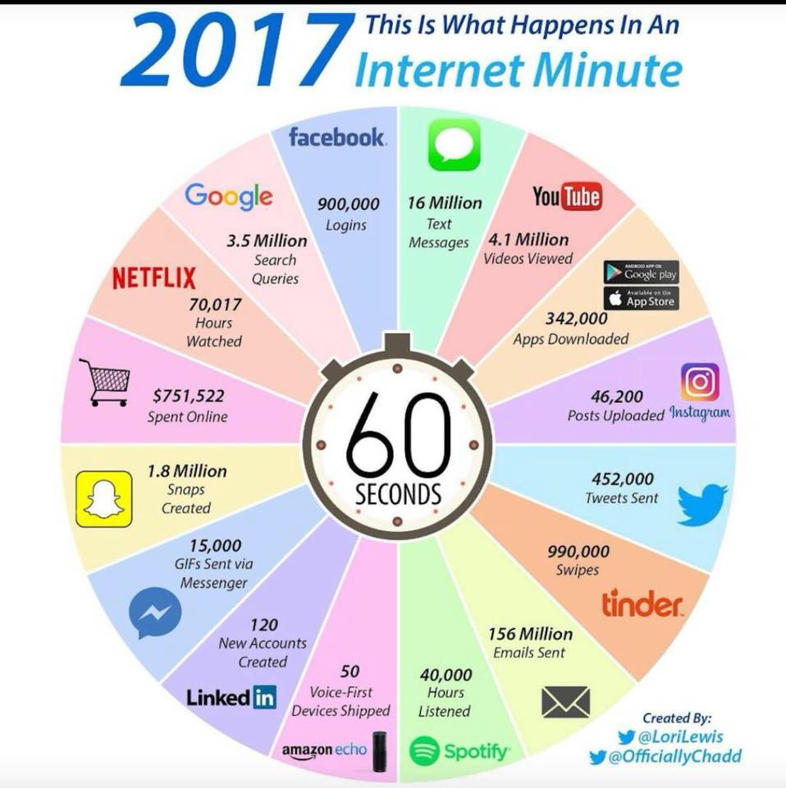

Slide 130
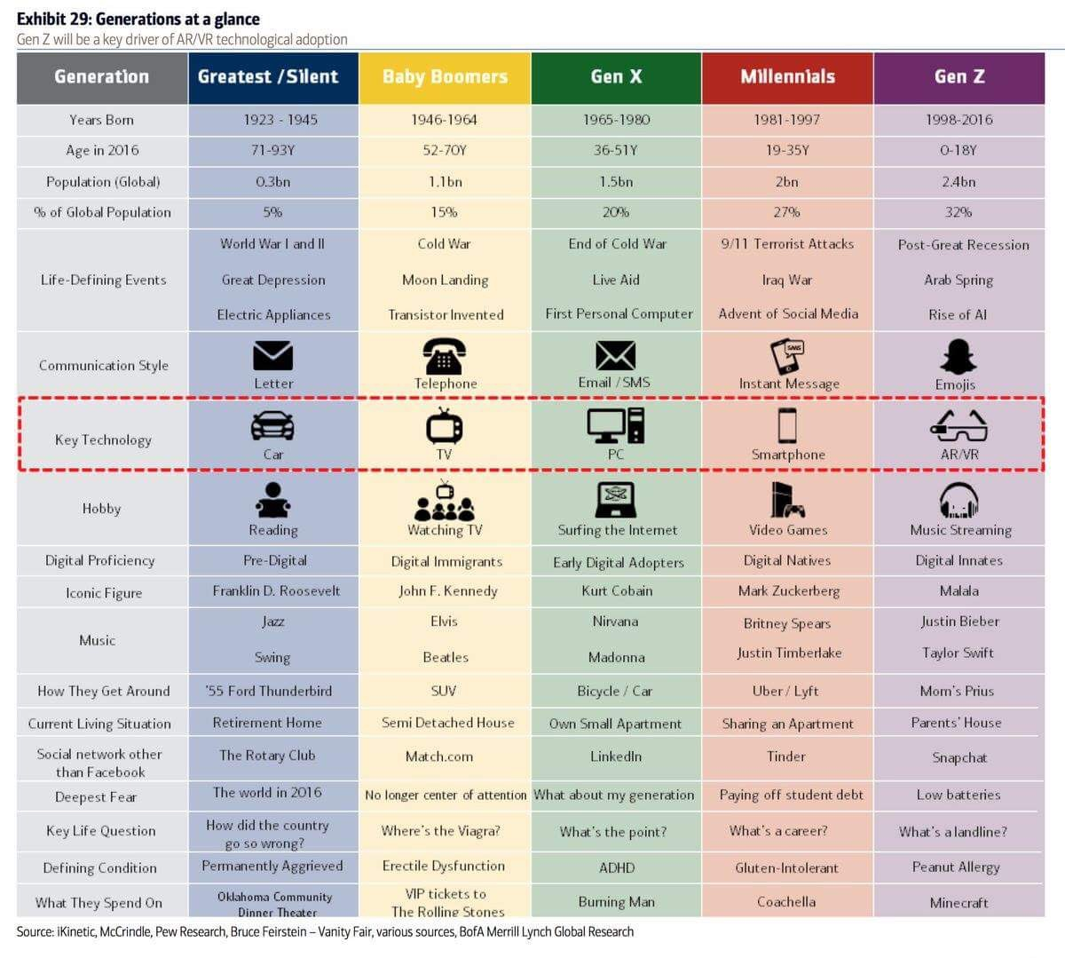

Slide 131
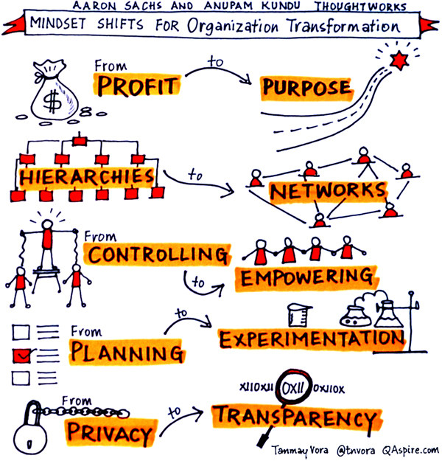
Millennials and Non-Millennials in the Age of Millennials

Slide 132
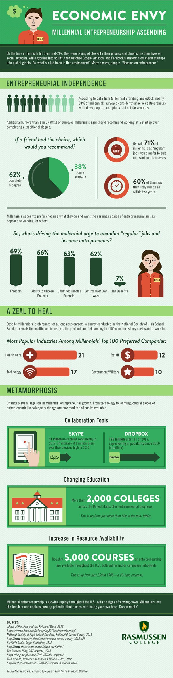
Millennials and Non-Millennials in the Age of Millennials

Slide 133
Employee Engagement Meta-analysis
(Most current 2016)
Business units that scored high on the 12 elements consistently
performed better than those that scored low. Highly engaged team
have increases in business outcomes.
10% higher success rate on customer metrics..
21% higher success rate in productivity.
20% higher success rate in profitability.
Results show that top quartile business units outperform bottom
Quartile units
Engagement Index Gallup Organization
1.8 Million Employees
49 Industries
82,000 Business/Work Units
Data gathered over 20-year period
73 Countries

Slide 134
Q 12 Process
Do I know what is expected of me at work?
Do I have the materials and equipment I need to do my work right?
At work, do I have the opportunity to do what I do best every day?
In the last seven days, have I received recognition or praise for good work?
Does my supervisor or someone else at work seem to care about me as a person?
Is there someone at work who encourages my development?

Slide 135
Q-12 Process
7. At work, do my opinions seem to count?
8. Does the mission/purpose of my company make me feel like my work is important?
9. Are my co-workers committed to doing quality work?
Does my supervisor create an environment where I can build good working relationships with my associates?
In the last six months, have I talked with someone about my progress?
At work, have I had opportunities to learn and grow?

Slide 136
Answer agree/neutral/disagree
Our organization has a variety of projects that challenge
and excite our employees.
Our organization exposes our employees to people and projects
outside their direct area.
People understand how their work contributes to the
organization’s overall goals.
Our organization supports the concept of lifelong learning
Our organization fosters a sense of individual growth
through assigned work and
training.

Slide 137
Everyone’s ideas are heard, valued and
possibly implemented.
Our organization facilitates exposure to ideas outside
the organization Itself.
Our organization moves at the right pace,
not too fast and not too slow.
We have a feedback centered organization

